Slide 1
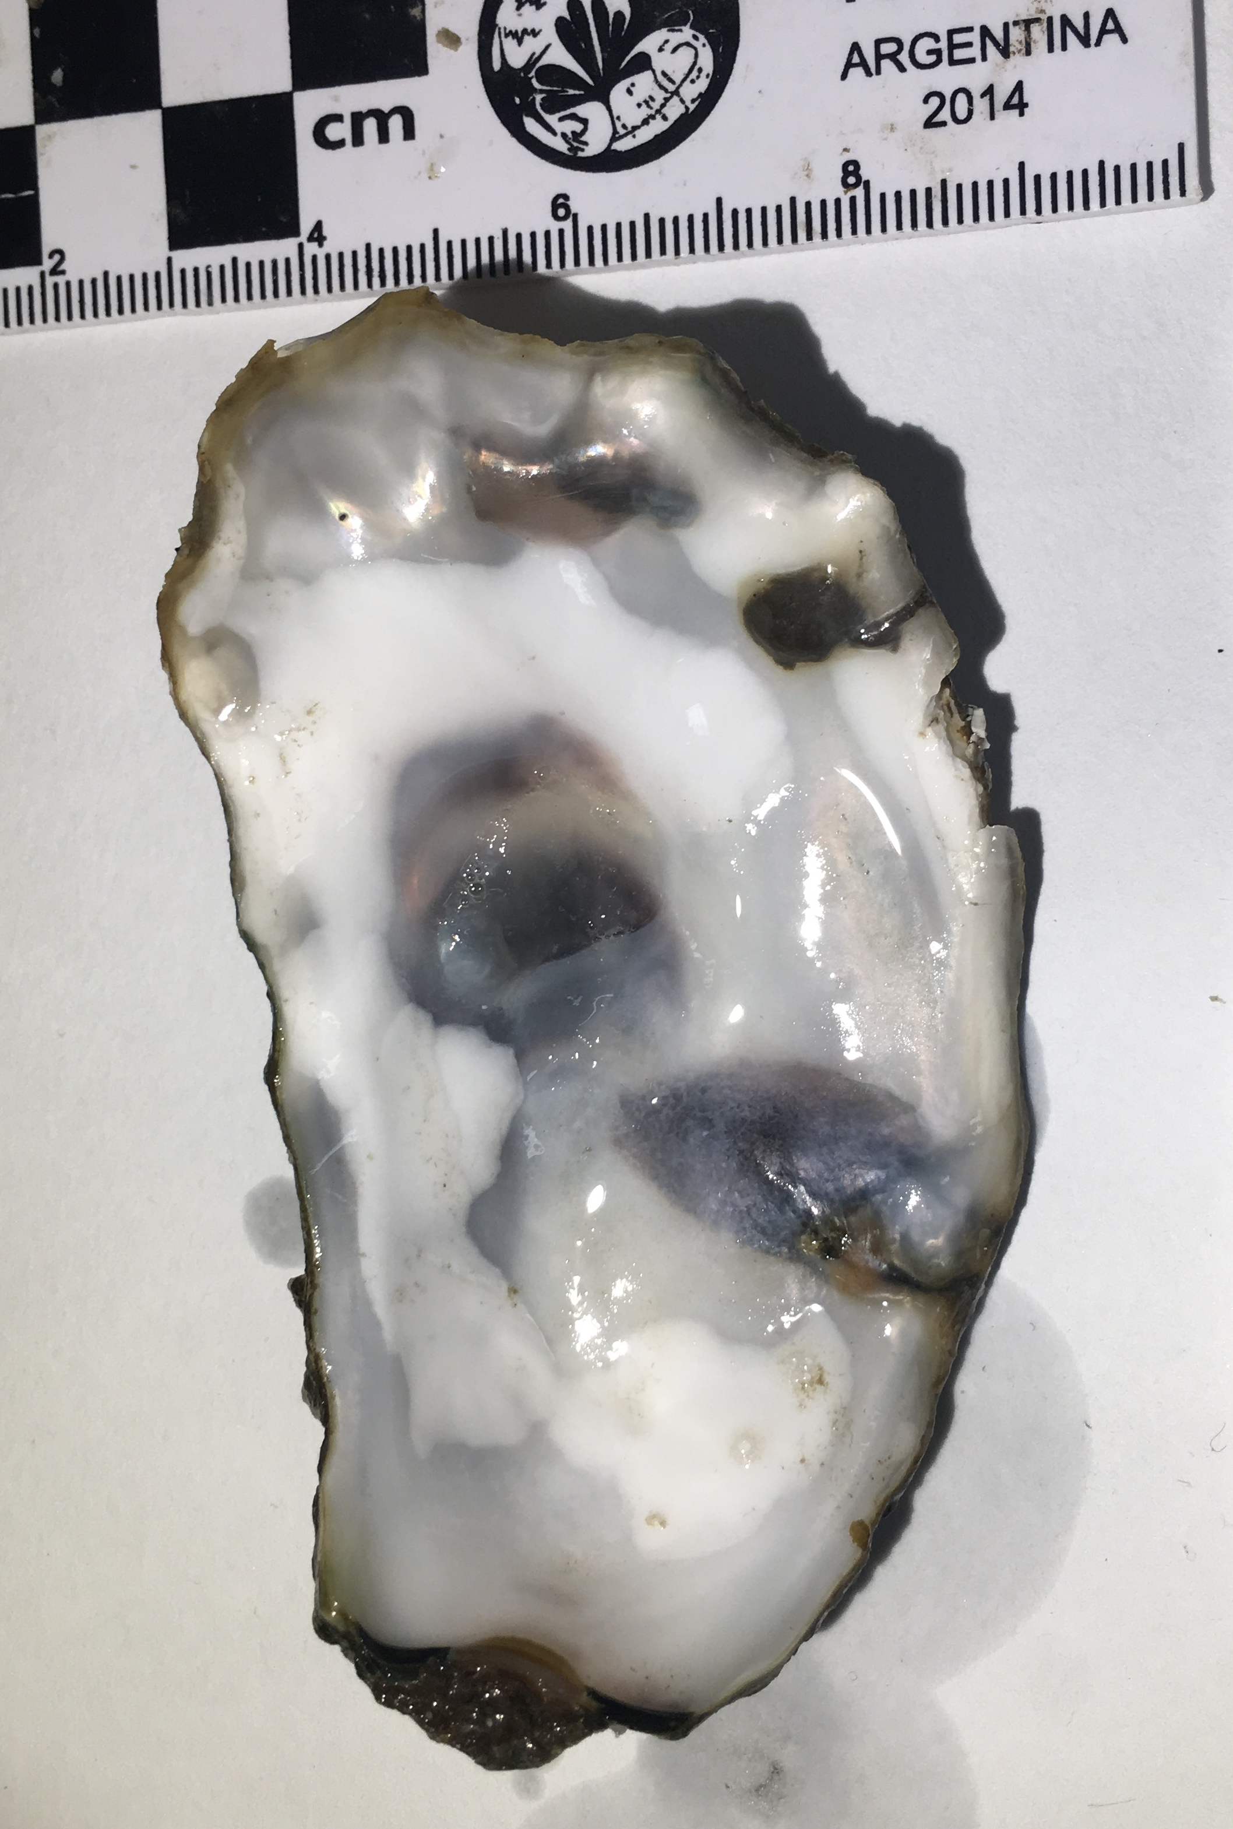
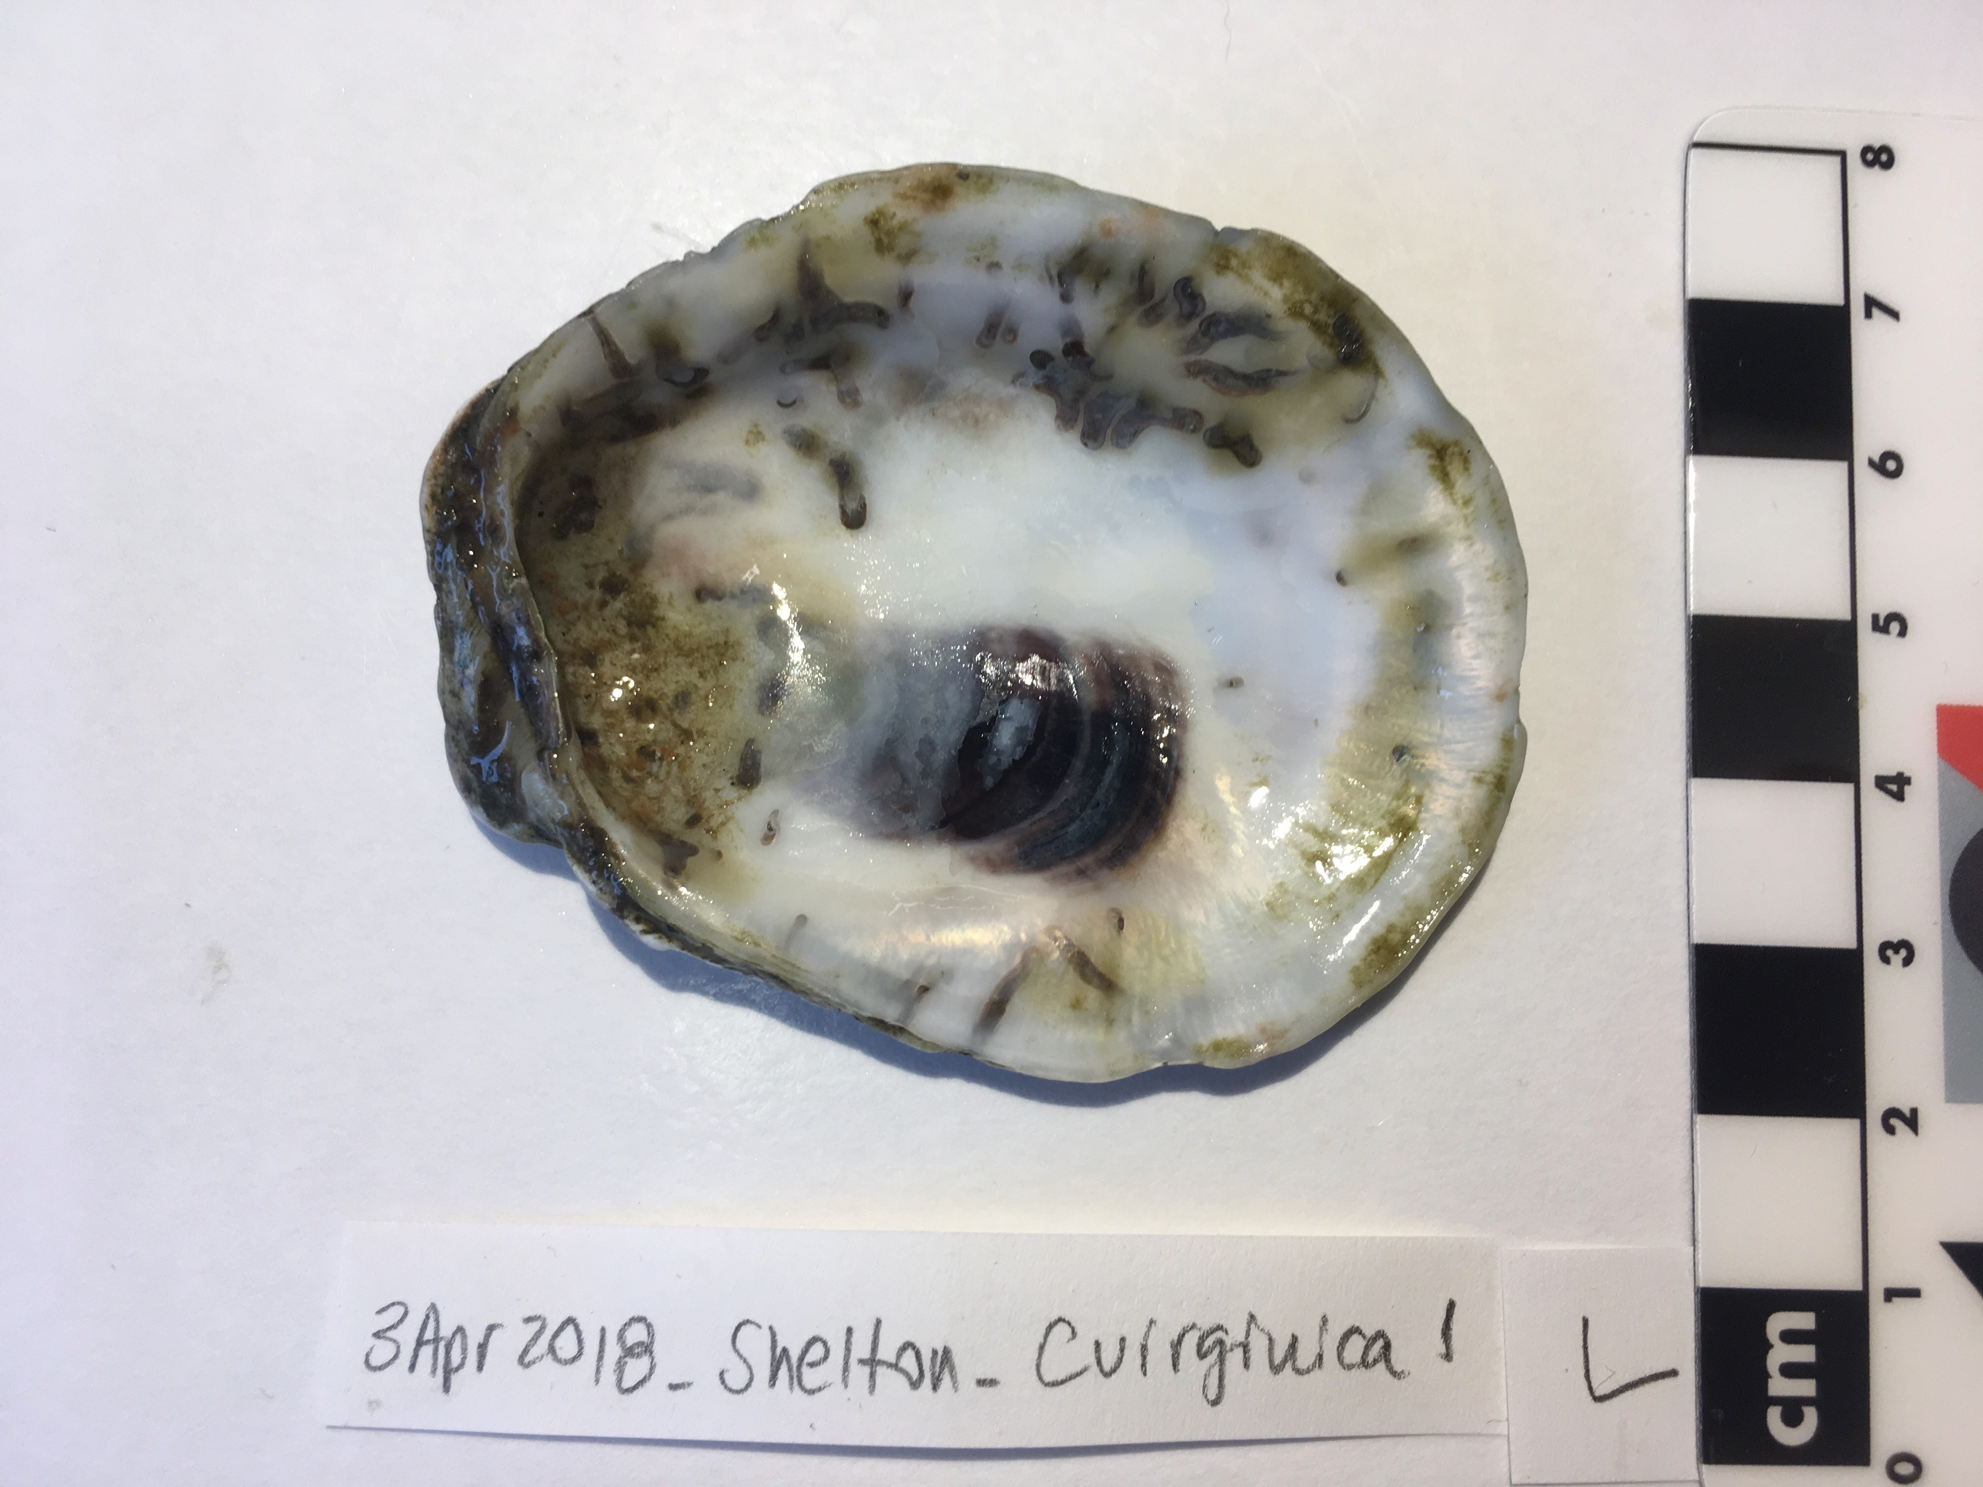
A
B
Notes:
A: C. gigas right valve: 28Jan18_Oakland_Oyster20_R
B: C. virginica left valve: 3April2018_TaylorShelton_Cvirginica1_L

Slide 2
2 mm
C
Notes:
A: C. gigas right valve: 28Jan18_Oakland_Oyster20_R
B: C. virginica left valve: 3April2018_TaylorShelton_Cvirginica1_L

Slide 3
NPS: $7.3M (8%)
Oakland Bay
Totten Inlet
CPS: $19K (<1%)
SPS
SJF: $455K (<1%)
HC: $11.6M (13%)
GH: $4.0M (4%)
SPS: $53.2M (58%)
WB: $15.6M (17%)
Shellfish production by value and percent of total Washington State 2015 production in each aquaculture area (designated by WA Dept. of Fish and Wildlife) where NPS=North Puget Sound (8%), CPS=Central Puget Sound (<1%), SPS=South Puget Sound (58%), HC=Hood Canal (18%); SJF=Strait of Juan de Fuca (<1%); GH=Grays Harbor (4%), and WB=Willapa Bay (17%). Inlay shows locations in South Puget Sound where Polydora websteri was positively identified in 2017.

